Slide 1
Towards a Software Greenability Model
Master Thesis Defense
Kirsten Gericke
7 August 2024

Slide 2
Overview of the contents
Introduction
Problem Statement
Research Questions
Research Method
Background
Definitions
Sigrid
Model Design
Validation
Methodology
Results
Survey
Discussion
Final Remarks

Slide 3
Problem Statement
introduction
Sustainable Software is software that minimizes its negative impacts on the environment, economy, and society throughout its life cycle.
The Corporate Sustainability Reporting Directive (CSRD) is a new European Union (EU) legislation that requires all large companies to publish regular reports on their social and environmental impact.
“Greenability” refers to the ability of software to become more sustainable through the ease of implementing green software refactorings that reduce energy consumption.

Slide 4
Important Concepts
introduction
Greenability
Properties and Metrics
Effort
Refactorings

Slide 5
Research Questions
introduction
1
Which software quality properties determine software “Greenability”?
2
Which software quality metrics determine software “Greenability”?
3
How does the predictive accuracy of the model compare to developer’s perceived refactoring effort?
How can the application of the model yield actionable, specific insights and recommendations to enhance software practices?
4

Slide 6
Contributions
introduction
Greenability Model: Properties and Metrics
Correlation between Greenability Properties and Metrics, and the Effort required for Code Refactorings
Survey gathering software developer’s Percieved Effort for code refactorings
Comparison of Measured and Perceived Effort

Slide 7
Research Methods
introduction
1. Literature Review
2. Correlation Analysis
3. Survey
Theoretical foundation
Software quality literature
Using Sigrid
Measure Effort
Measure Greenability
Analyze the relationship between the two
Software Engineers, Developers, and Technical Consultants
Perceived Effort
Compare Measured and Perceived Effort

Slide 8
Overview of the contents
Introduction
Problem Statement
Research Questions
Research Method
Background
Definitions
Sigrid
Model Design
Validation
Methodology
Results
Survey
Discussion
Final Remarks

Slide 9
Hierarchical Structure Example
Properties contain multiple sub-characteristics, and these are measured by various metrics.
Maintainability
Modifiability
Analyzability
Modularity
…
Unit Complexity
Duplication
Module Coupling
…

Slide 10
Defining Effort
Background
How much effort is required to implement a task/refactoring?
Subjective: Depends on skills, experience, and working styles
Ways of measuring effort:
Time
Cognitive Load
LOC changed
Before and After
Churn
Convert LOC to Person Months
Effort is the churn, measured in Person Months, while implementing a code refactoring.

Slide 11
Sigrid: SIG’s metric measurement tool
Background
Sigrid = Static Source Code Analysis Tool
Sigrid measures properties on a scale from 0.5 to 5.5
Compared to SIG benchmark
Used later in this thesis
5% least maintainable in SIG benchmark
next 30%
next 30%
next 30%
5% most maintainable
★☆☆☆☆
★★☆☆☆
★★★☆☆
★★★★☆
★★★★★
MARKET-AVERAGE
0.5 1.5 2.5 3.5 4.5 5.5

Slide 12
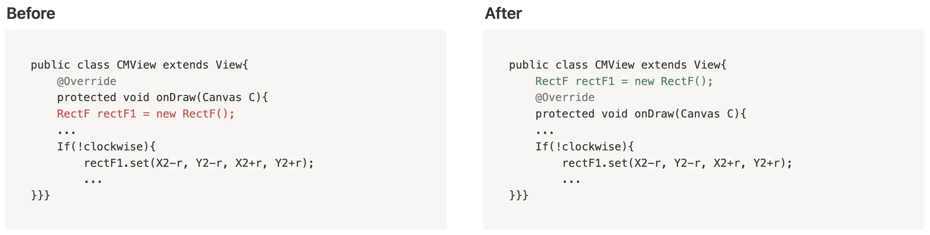
Green Software Patterns
Background
Green Patterns are design and coding practices aimed at improving the energy efficiency of software.
Source Code Level (e.g. use ArrayMap instead of HashMap)
Design Level (e.g. opt for dark colours when designing the UI)
Example: DrawAllocation
Notes:
Example:
DrawAllocation “occurs when new objects are allocated along with draw operations, which are very sensitive to performance. In other words, it is a bad design practice to create objects inside the onDraw method of a class which extends a View Android component.”

Slide 13
Overview of the contents
Introduction
Problem Statement
Research Questions
Research Method
Background
Definitions
Sigrid
Model Design
Validation
Methodology
Results
Survey
Discussion
Final Remarks

Slide 14





Greenability Properties Selection
Model Design
other
Reliability
Accessibility
Usability
Performance Efficiency
Dependability
Architecture
Quality
Functional
Suitability
Security
Open-Source Health
Understand-
ability
Portability
Maintainability
Cloud Readiness
Compatibility
Used in
Greenability
Model

Slide 15
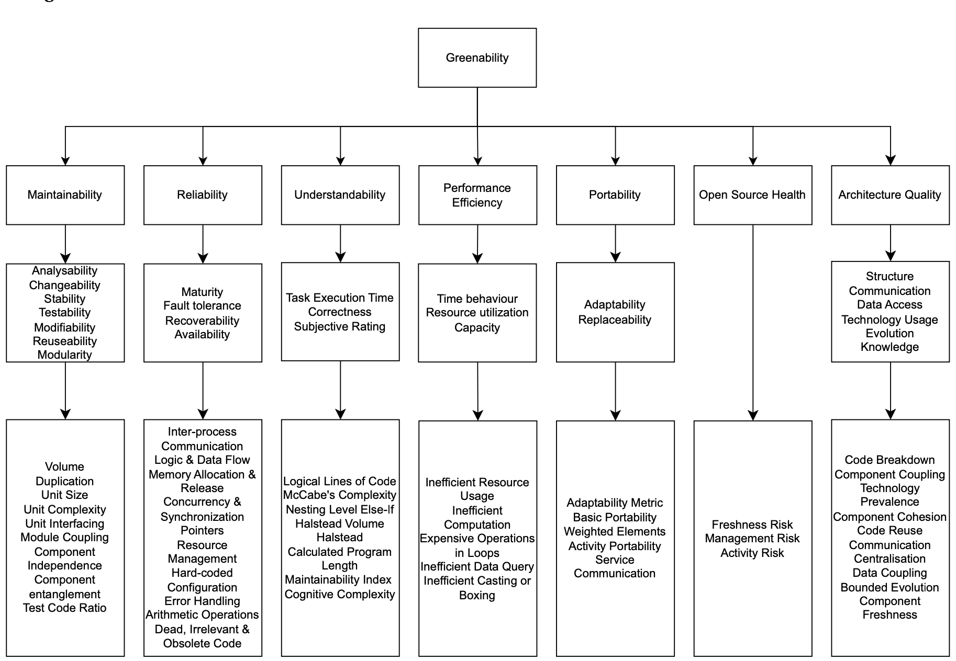
Software Greenability Model Overview
Model design

Slide 16
Software Greenability Model Overview
Model design
Greenability
Maintainability
Reliability
Open Source Health
Architecture Quality
Volume
Duplication
Unit Complexity
Unit Interfacing
Module Coupling
Test Code Ratio
Reliability
Freshness Risk
Management Risk
Activity Risk
Code Breakdown
Component Coupling
Technology Prevalence
Component Cohesion
Code Reuse
Communication Centralization

Slide 17
Overview of the contents
Introduction
Problem Statement
Research Questions
Research Method
Background
Definitions
Sigrid
Model Design
Validation
Methodology
Results
Survey
Discussion
Final Remarks

Slide 18
Correlation Analysis Methodology
Validation
Validate that the selected Greenability Properties and Metrics do impact the effort needed to implement Green Software Patterns.

Slide 19

Correlation Analysis Methodology
Validation
Original
Source Code
Greenability Metric Measurements
Spearman Correlation Analysis
Refactored
Source Code
Churn Measurements (LOC Changed)

Slide 20
Selection Criteria
Validation
1. Repository
2. Systems
3. Refactorings

Slide 21
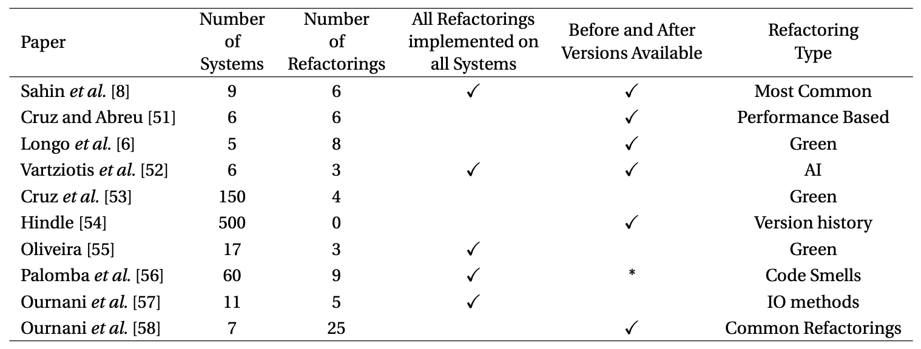
Repository Selection Criteria
Validation
Multiple systems of varying sizes and characteristics are refactored. This is to show the effect of Greenability metrics on churn results.
Before and After versions of refactored systems are available. This is required for churn results to be calculated.
All refactorings were implemented on all systems. It will not be possible to compare two Greenability metrics from systems refactored in different ways.
Valid refactorings were implemented that are proven to reduce energy consumption
Repositories considered

Slide 22
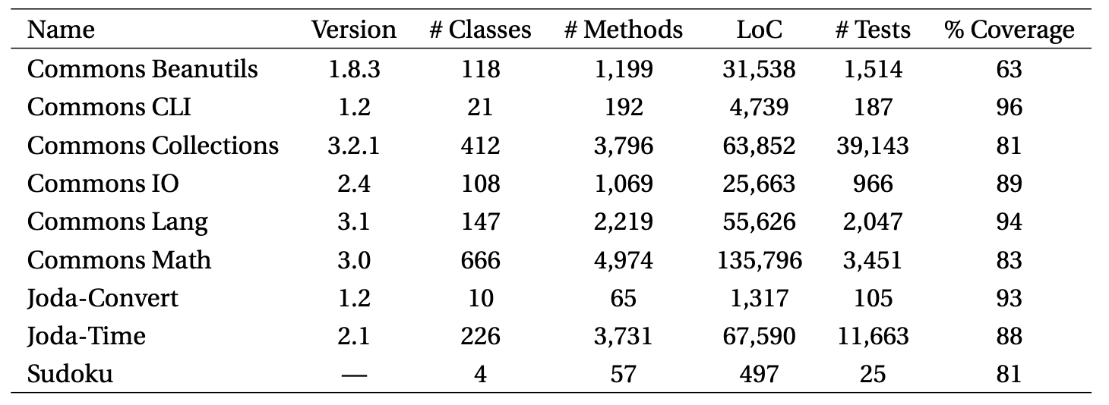
System Selection Criteria
Size Diversity
Test Coverage
Variety of
Application Domains
Availability of
Extensive Test Suites
Source: C. Sahin, L. L. Pollock, and J. A. Clause, “How do code refactorings affect energy usage?” In International Symposium on Empirical Software Engineering and Measurement, 2014. [Online]. Available: https:// api.semanticscholar.org/CorpusID:14237840.

Slide 23
Refactoring Selection Criteria
Validation
6 Refactorings:
Convert Local Variable to Field
Extract Local Variable
Extract Method
Introduce Indirection
Inline Method
Introduce Parameter Object
Commonly used by developers (Eclipse Usage Data Collector)
Structural Changes reflected in the application’s compiled bytecode (e.g. renaming variables or methods were excluded)
Applicable to all systems such that they contain locations where preconditions for applying refactorings are met
Provides Multiple Data Points (e.g. refactorings that could only be applied in very specific circumstances were excluded)

Slide 24
Results
Validation
Original
Source Code
Greenability Metric Measurements
Spearman Correlation Analysis
Refactored
Source Code
Churn Measurements (LOC Changed)

Slide 25
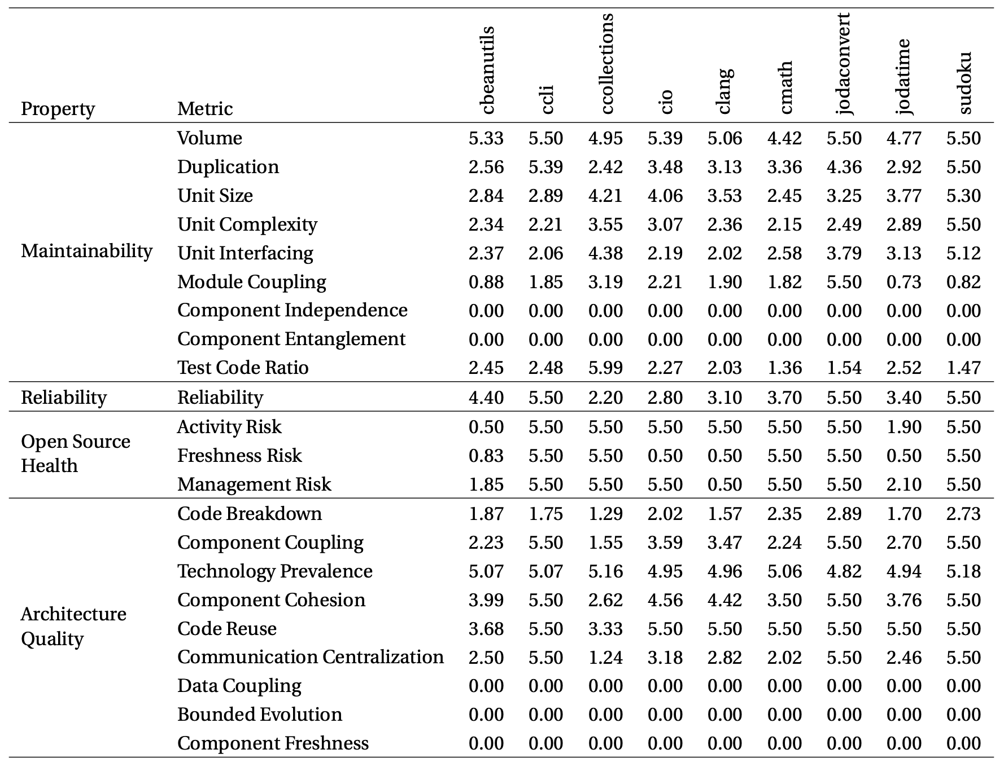
Greenability Metric Measurements
Validation
Systems
Metrics
Sigrid 5 star
Scale Rating

Slide 26
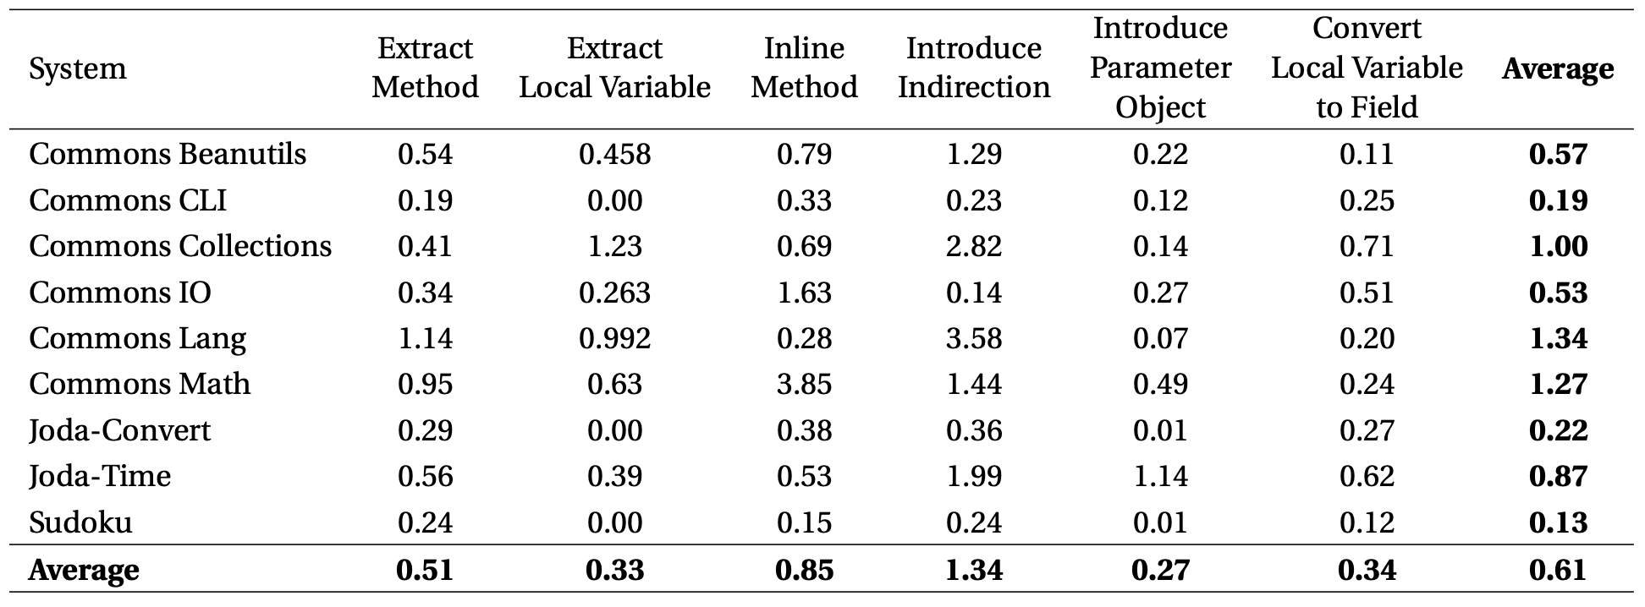
Effort Measurements
Validation
Refactorings
Systems
Effort = LOC changed (in Person Months)

Slide 27
Effort per Refactoring per Metric
Validation
Systems
Metrics
Refactorings
Metrics
Refactorings
Systems

Slide 28
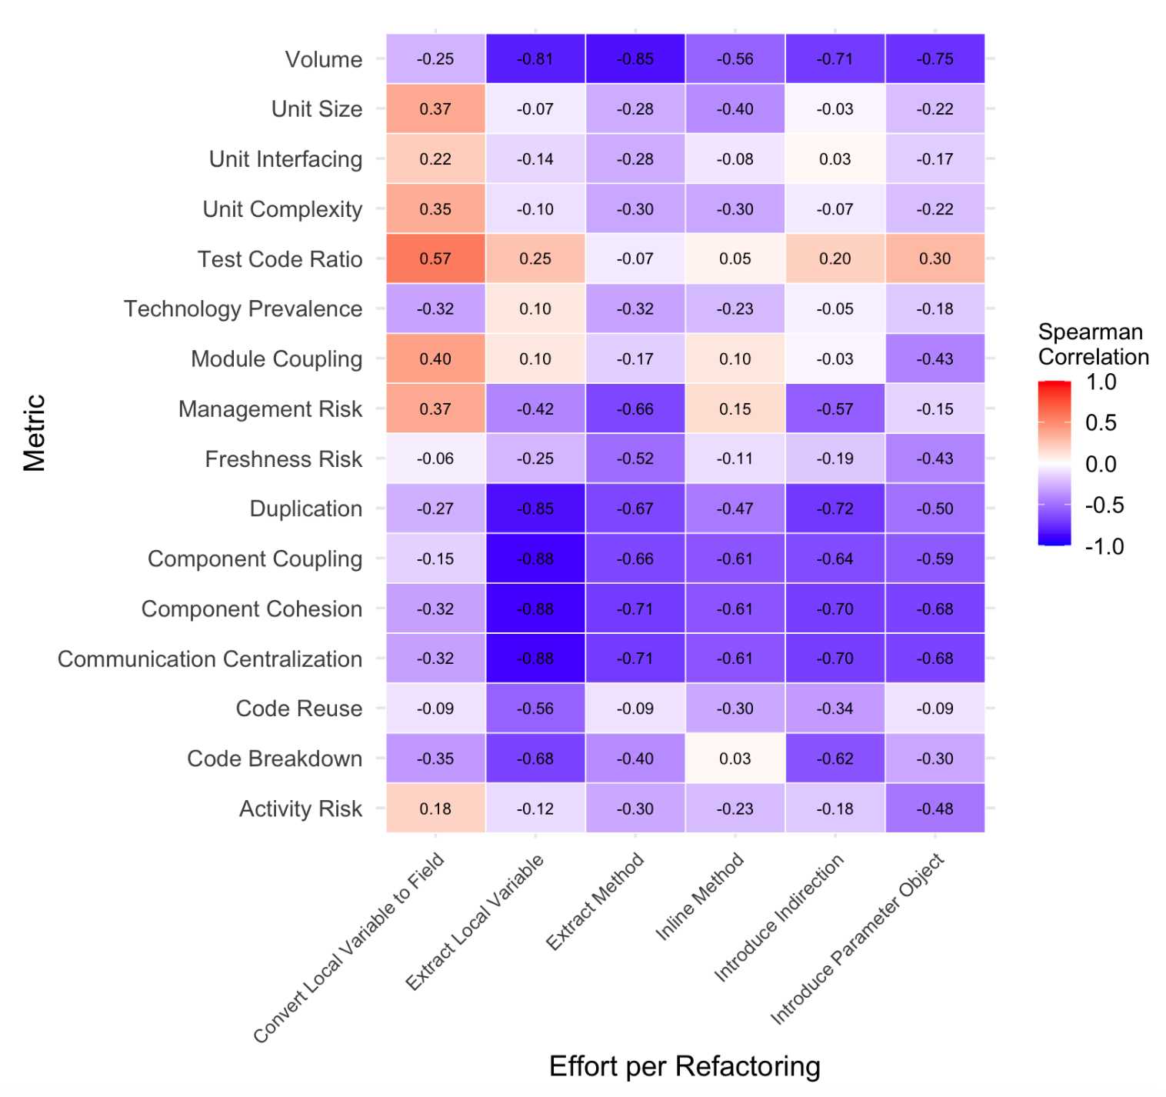
Effort per Refactoring per Metric
Validation
Metrics
Negative Correlation:
Higher Metric Score
=
Less Effort
Effort per Refactoring

Slide 29
Why is the survey necessary?
Validation
Low number of data points
Is Churn the best way to measure effort?
Consider a different perspective: Percieved Effort
Compare Measured and Perceived Effort

Slide 30

Survey Methodology
Validation
6 Refactoring Examples
Survey
Perceived Effort
25 Software
Engineers
5 Greenability Properties

Slide 31
Surveyed Properties
Validation
Maintainability
Architecture Quality
Reliability
Freshness
Performance Efficiency
Sub-set of Open Source Health
Added Extra

Slide 32
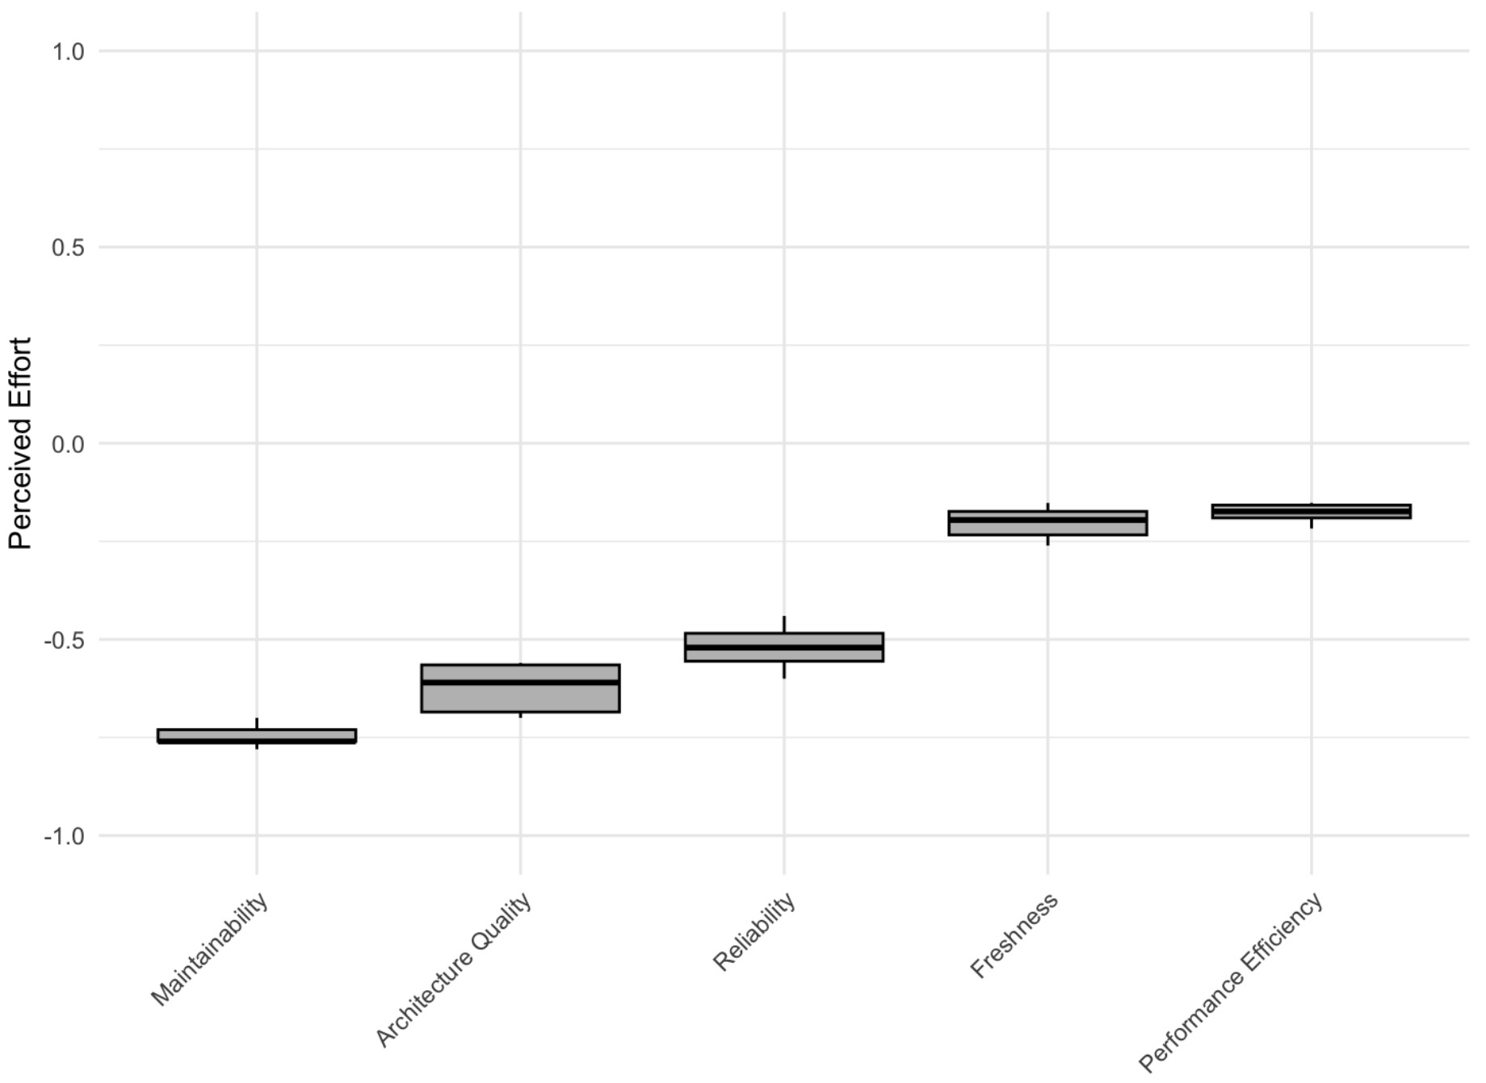
Survey Results
Validation
More Effort
No impact
on Effort
Maintainability
Is most important
Less Effort

Slide 33
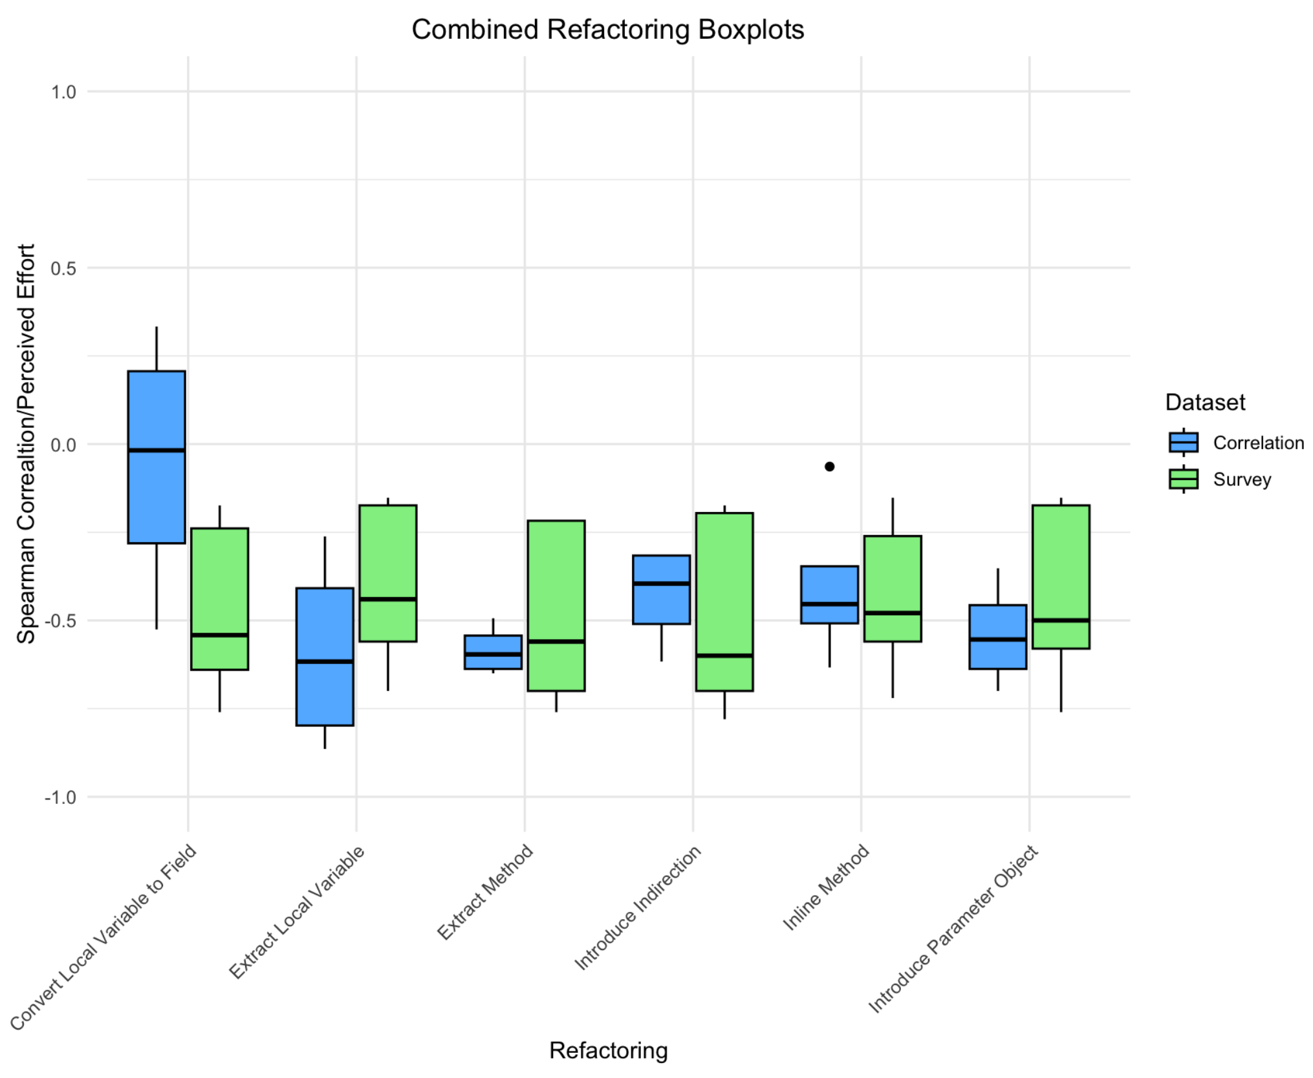
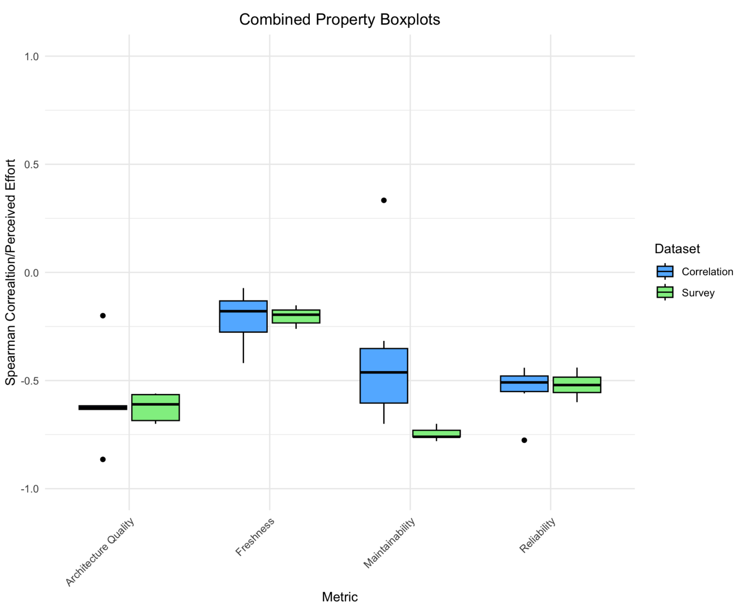
Comparing Measured and Percieved Effort
results
Refactorings
Properties

Slide 34
Overview of the contents
Introduction
Problem Statement
Research Questions
Research Method
Background
Definitions
Sigrid
Model Design
Validation
Methodology
Results
Survey
Discussion
Final Remarks

Slide 35
Research Question Answers
Research Questions
Which software quality properties determine software “Greenability”?
1
Which software quality metrics determine software “Greenability”?
2
How does the predictive accuracy of the model compare to developer’s perceived refactoring effort?
3
How can the application of the model yield actionable, specific insights and recommendations to enhance software practices?
4

Slide 36
Research Question Answers
Research Questions
Which software quality properties determine software “Greenability”?
1
On average, all refactorings are easier to implement if any Greenability Property is improved. This is true for both measured and perceived effort.
Architecture Quality and Reliability are the Greenability Properties with the biggest measured impact on ease of refactorings.
Which software quality metrics determine software “Greenability”?
2
How does the predictive accuracy of the model compare to developer’s perceived refactoring effort?
3
How can the application of the model yield actionable, specific insights and recommendations to enhance software practices?
4

Slide 37
Research Question Answers
Research Questions
Which software quality properties determine software “Greenability”?
1
Higher Greenability Metric scores, on average, reduce the effort required for all code refactorings.
Volume has the greatest measured impact on the ease of code refactorings.
Which software quality metrics determine software “Greenability”?
2
How does the predictive accuracy of the model compare to developer’s perceived refactoring effort?
3
How can the application of the model yield actionable, specific insights and recommendations to enhance software practices?
4

Slide 38
Research Question Answers
Research Questions
Which software quality properties determine software “Greenability”?
1
Developers’ perception of effort aligned accurately with measured effort results for most properties, except Maintainability, which they overestimate
Maintainability: most important
Performance Efficiency and Freshness: no perceived impact
Which software quality metrics determine software “Greenability”?
2
How does the predictive accuracy of the model compare to developer’s perceived refactoring effort?
3
How can the application of the model yield actionable, specific insights and recommendations to enhance software practices?
4

Slide 39
Research Question Answers
Research Questions
Which software quality properties determine software “Greenability”?
1
The Greenability Model helps developers identify software quality properties needing improvement to reduce refactoring effort.
Specifically target Architecture, Reliability and Maintainability
Address low-scoring properties and metrics
Which software quality metrics determine software “Greenability”?
2
How does the predictive accuracy of the model compare to developer’s perceived refactoring effort?
3
How can the application of the model yield actionable, specific insights and recommendations to enhance software practices?
4

Slide 40
Threats to Validity
1. Definition of Effort
Accounted for by considered 2 definitions, but still very complex
2. Number of Data Points
9 systems x 6 Refactorings x 4 implementations = 216 Files
Average 4 implementations: 9 systems x 6 Refactorings = 54 files
25 survey participants
3. Impact of the Refactorings on Energy Consumption
“refactorings can not only impact energy usage but can also increase and decrease the amount of energy used by an application.”. [1]
[1] C. Sahin, L. L. Pollock, and J. A. Clause, “How do code refactorings affect energy usage?” In International Symposium on Empirical Software Engineering and Measurement, 2014. [Online]. Available: https:// api.semanticscholar.org/CorpusID:14237840.

Slide 41
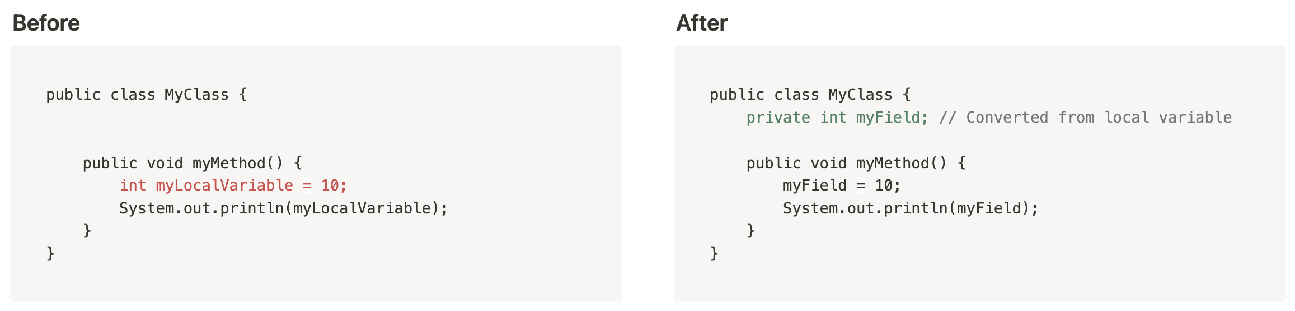
Refactoring Similarities Example
discussion
Green Pattern:
DrawAllocation
Common Refactoring:
Convert Local
Variable to Field

Slide 42
Overview of the contents
Introduction
Problem Statement
Research Questions
Research Method
Background
Definitions
Sigrid
Model Design
Validation
Methodology
Results
Survey
Discussion
Final Remarks

Slide 43
Final Remarks
conclusion
If Greenability Properties and Metrics are improved, all refactorings are easier to implement.
The model is based on standardised concepts and combines mutliple definitions of effort.
Encourages further research and improvements in Software Sustainability.

